Slide 1

Applied Distributed Systems
The Cloud 2

Slide 2
Overview
Failure in the Cloud
Sharing data

Slide 3
A distributed system is one in which the failure of a computer you didn't even know existed can render your own computer unusable.
Leslie Lamport

Slide 4
Failures in the cloud
Cloud failures large and small
The Long Tail
Techniques for dealing with the long tail

Slide 5
Sometimes the whole cloud fails
Selected Cloud Outages 2020
Twitter
Microsoft Azure
Microsoft Teams. .
Google Cloud Platform
YouTube.
AWS

Slide 6
And sometimes just a part of it fails …

Slide 7
A year in the life of a Google datacenter
Typical first year for a new cluster:
~0.5 overheating (power down most machines in <5 mins, ~1-2 days to recover)
~1 PDU failure (~500-1000 machines suddenly disappear, ~6 hours to come back)
~20 rack failures (40-80 machines instantly disappear, 1-6 hours to get back)
~5 racks go wonky (40-80 machines see 50% packetloss)
~8 network maintenances (4 might cause ~30-minute random connectivity losses)
~12 router reloads (takes out DNS and external vips for a couple minutes)
~3 router failures (have to immediately pull traffic for an hour)
~dozens of minor 30-second blips for dns
~1000 individual machine failures
~thousands of hard drive failures
slow disks, bad memory, misconfigured machines, flaky machines, dead horses, …

Slide 8
Amazon failure statistics
In a data center with ~64,000 servers with 2 disks each
~5 servers and ~17 disks fail every day.

Slide 9
Failures in the cloud
Cloud failures large and small
The Long Tail
Techniques for dealing with the long tail

Slide 10
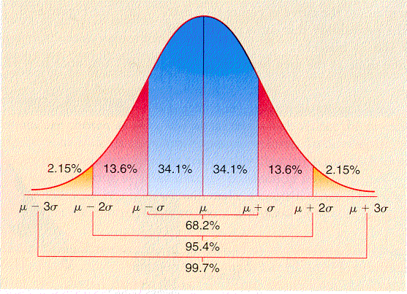
Short digression into probability
A distribution describes the probability than any given reading will have a particular value.
Many phenomenon in nature are “normally distributed”.
Most values will cluster
around the mean with
progressively smaller
numbers of values going
toward the edges.
In a normal distribution
the mean is equal to the
median

Slide 11
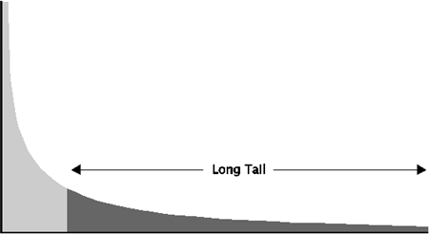
Long Tail
In a long tail distribution, there are some values far from the median.
These values are sufficient to influence the mean.
The mean and the
median are
dramatically
different in a long
tail distribution.

Slide 12
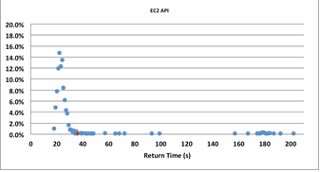
What does this mean?
If there is a partial failure of the cloud some activities will take a long time to complete and exhibit a long tail.
The figure shows
distribution of
1000 AWS
“launch instance”
calls.
4.5% of calls were
“long tail”

Slide 13
Failures in the cloud
Cloud failures large and small
The Long Tail
Techniques for dealing with the long tail

Slide 14
What can you do to prevent long tail problems?
Recognize that failure has occurred
Recover from failure
Mask failure

Slide 15
Recognizing failure
In a distributed system, the only communication between distinct computers is through messages.
An unanswered request (message) to another machine may indicate the recipient has failed.
The failure is recognized by the requestor making the request.
Requests are asynchronous. The requestor sets a timeout.

Slide 16
Health Check
Health check. Requires one machine to act as a monitor for other machines.
Machine sends a message to a monitor periodically saying “I am alive”
Ping/echo. Monitor sends a message to the machine being monitored and expects a reply within specified period.

Slide 17
Recovering from failure
Retry
Instantiate another instance of failed service
Graceful degradation
Set “circuit breaker” to prevent trying to use service again.

Slide 18
Masking failure
“Hedged” request. Suppose you wish to launch 10 instances. Issue 11 requests. Terminate the request that has not completed when 10 are completed.
“Alternative” request. In the above scenario, issue 10 requests. When 8 requests have completed issue 2 more. Cancel the last 2 to respond.
Using these techniques reduces the time of the longest of the 1000 launch instance requests from 202 sec to 51 sec.

Slide 19
Overview
Failure in the Cloud
Sharing data

Slide 20
Sharing data across portions of a distributed app
Different portions of a distributed app may wish to share data without the latency of message passing and writing to persistent storage.
Shared data is frequently the basis of operations that must appear to be atomic.

Slide 21
Atomicity
An atomic operation is one that cannot be interrupted.
Atomic operations appear to be instanteous.
Difficult to achieve in distributed systems because of the reliance on messages.

Slide 22
Message timing considerations
Main memory reference 100 ns
1K bytes over 1 Gbps network 0.01 ms
Round trip within same datacenter 0.5 ms
Packet CA->Netherlands->CA 150 ms
Maintaining appearance of atomicity using messages will take time

Slide 23
Non-atomic operations can cause problems
Problems that may result from non atomic operations.
Data base updates may result in inconsistent data
Resources (e.g. memory) may be overwritten
Interrupt handlers might themselves be interrupted
Etc

Slide 24
Atomicity in distributed systems
The appearance of atomicity can be achieved at low latency by the use of an intermediary
Problem comes if intermediary fails.

Slide 25
Types of fast, in memory intermediaries
Strictly data storage
Memcached
Distributed coordination systems
Zookeeper
etcd
Consul

Slide 26
Memcached - 1
Key-value database
Key up to 250 bytes
Value up to 1 megabyte
Client – server
Multiple servers, known to all clients

Slide 27
Memcached - 2
Data Is divided among servers based on a hash of the key
Hashing key yields a server number and that is the server on which the data is stored
Different clients with the same key can share data

Slide 28
Problems with Memcached
No failure recovery – if a server fails, data is lost
Any coordination among clients over a single data item is outside of the scope of memcached.

Slide 29
Distributed coordination systems
Fault tolerant with high availability
Manages coordination among clients.
Operations appear atomic

Slide 30
Locks as a use case
We will examine distributed coordination systems using locking in Zookeeper as a use case.
Other use cases are:
Leader election
Groups membership
Synchronization
Configuration

Slide 31
Locks
One technique to give the appearance of atomicity is to lock critical resources.
A lock is a software construct.
Associate with each resource a lock bit.
If bit is 0, no lock on resource
If bit is 1, resource is locked
In practice, locks have other information in addition to lock bit.

Slide 32
Problem with locks
Can lead to deadlock – two processes waiting for each other to release critical resources
Process one gets a lock on row 1 of a data base
Process two gets a lock on row 2.
Process one waits for process 2 to release its lock on row 2
Process two waits for process 1 to release its lock on row 1
No progress.

Slide 33
More problems with locks
Getting a lock across distributed systems is not an atomic operation.
It is possible that while requesting a lock another process can acquire the lock. This can go on for a long time (it is called livelock if there is no possibility of ever acquiring a lock)
Suppose the virtual machine holding the lock fails. Then the owner of the lock can never release it.

Slide 34
Locks in distributed systems
Utilizing locks in a distributed system has a more fundamental problem.
It takes time to send a message (create a lock, for example) from one computer to another.

Slide 35
Synchronizing data
The general problem is that you want to manage synchronization of data across a distributed set of servers where up to half of the servers can fail.
Paxos is a family of algorithms that use consensus to manage concurrency. Complicated and difficult to implement.
An example of the implementation difficulty
Choose one server as the leader that keeps the “authoritative” state.
Now that server fails. Need to
Find a new leader
Make sure it is up to data with the authoritative state.

Slide 36
Zookeeper as an example
Zookeeper provides a guaranteed consistent (mostly) data structure for every instance of a distributed application.
Definition of “mostly” is within eventual consistency lag (but this is small).
Zookeeper keeps data in memory. This is why it is fast.
Limited to 1 Mbyte
Zookeeper deals with managing failure as well as consistency.
Done using consensus algorithm.

Slide 37
Zookeeper API
All calls return atomic views of state – either succeed or fail. No partial state returned. Writes also are atomic. Either succeed or fail. If they fail, no side effects.
Function | Type
create | write
delete | write
Exists | read
Get children | Read
Get data | Read
Set data | write
+ others

Slide 38
Lock creation
Locks have names.
Client N
Create Lock1
If success then client owns lock.
If failure, then it is placed on waitlist for lock 1 and control is returned to Client N
When owner of Lock 1 finishes, it deletes Lock1
If there is a waitlist, then those clients are informed about Lock 1 deletion and they try again to create Lock 1
If Client N fails, Zookeeper will delete Lock 1 and waitlist clients are informed of deletion

Slide 39
Summary
Failure of VMs in the cloud is something that application programmers must allow for.
The long tail is an example of what can happen when a VM fails
Synchronization of data across a distributed system id complicated
Timing delays across distributed systems
Possible failures of nodes of various types
Open source systems implement complicated consensus algorithms in a fashion that is relatively easy to use.

